Slide 1
Webinar | Everything you need to know about the ecodesign.solar platform
Presentation of the new eco-design simulator features and the attestation request process
23rd September 2026

Slide 2

Agenda
Introduction
User journey (without account)
User journey (with account)
  Panel creation
  Eco-design simulation
  Results analysis
  Request for certificate
Tool demonstration

Slide 3

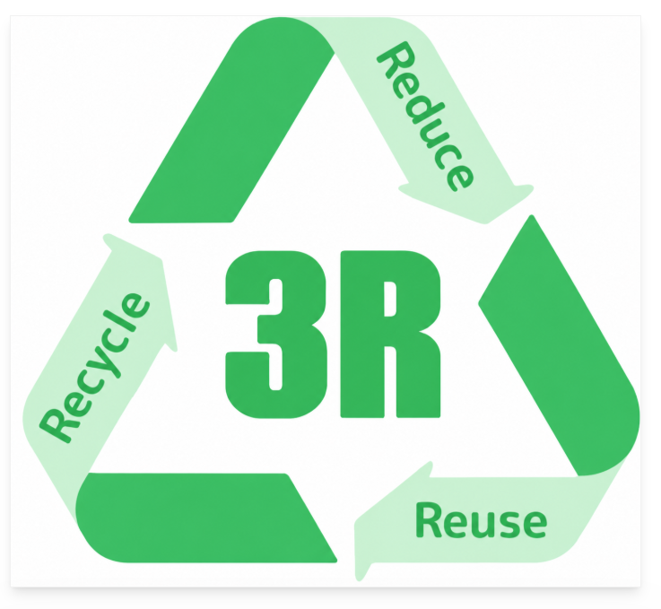


From 3R principles to the design decision
INTRODUCTION
INTRODUCTION
INTRODUCTION
Eco-design means taking action at the design stage to reduce impacts, extend the use of resources, and prepare them for recycling.
DESIGN
FOR
REDUCE
Minimize the use of energy and critical materials
ecodesign.solar
The simulator for turning intentions into results
1
SIMULATE
the effect of design choices
1
1
DESIGN
FOR
REUSE
Increase the use of recycled materials
1
2
COMPARE
several product scenarios
2
2
2
A CIRCULAR LOGIC
3
OBJECTIFY
levers for improvement
3
3
DESIGN
FOR
RECYCLE
Use materials that facilitate recycling
3
Discover how to use the simulator to inform your eco-design trade-off decisions.

Slide 4
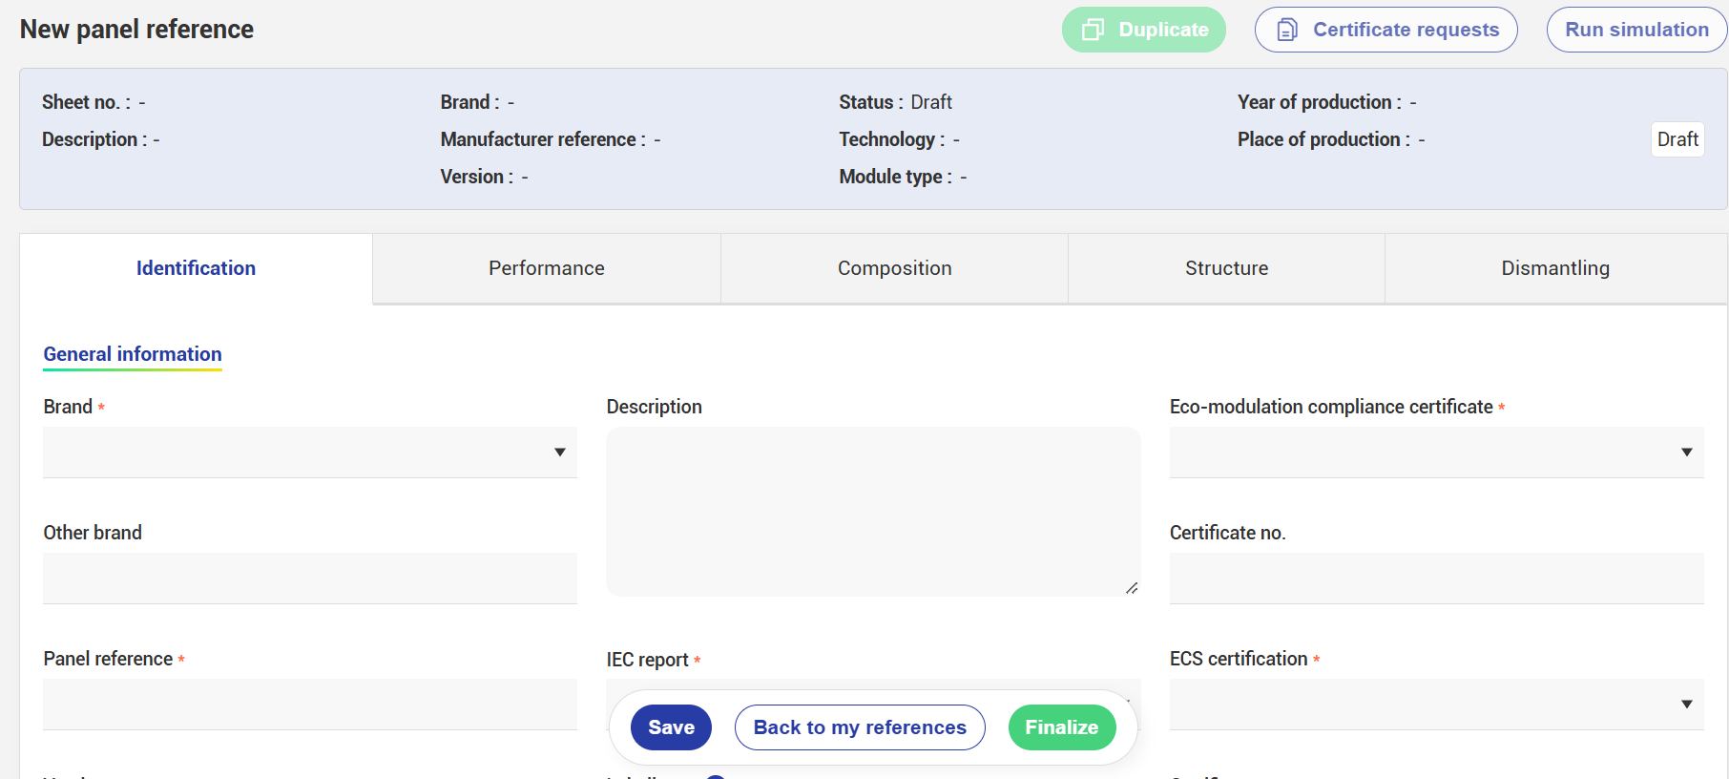
What's new
What is changing:
a new form for entering panel references
new environmental indicators to better assess your products
For a more comprehensive and seamless experience
Material balance
Recycling disruptors
Recovery rate
Recyclability index

Slide 5
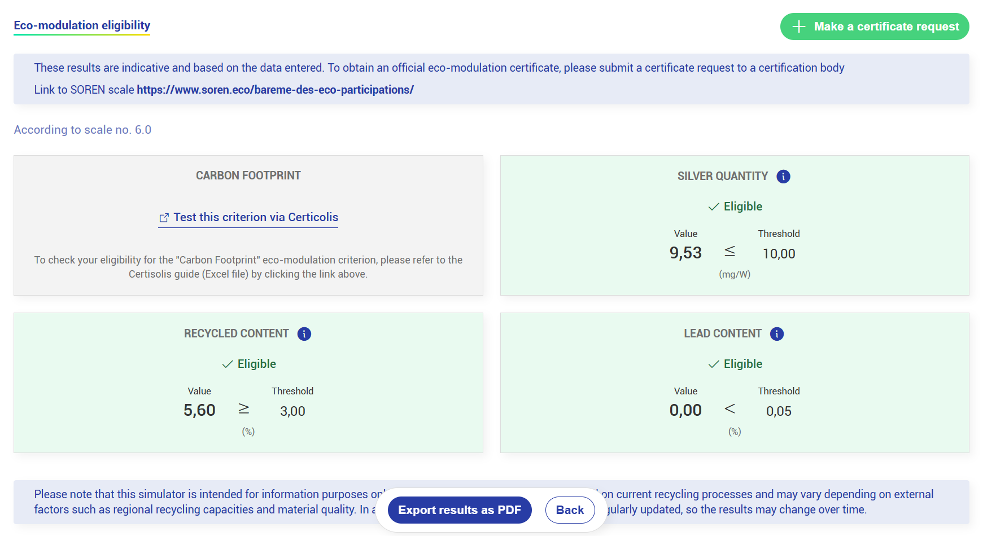
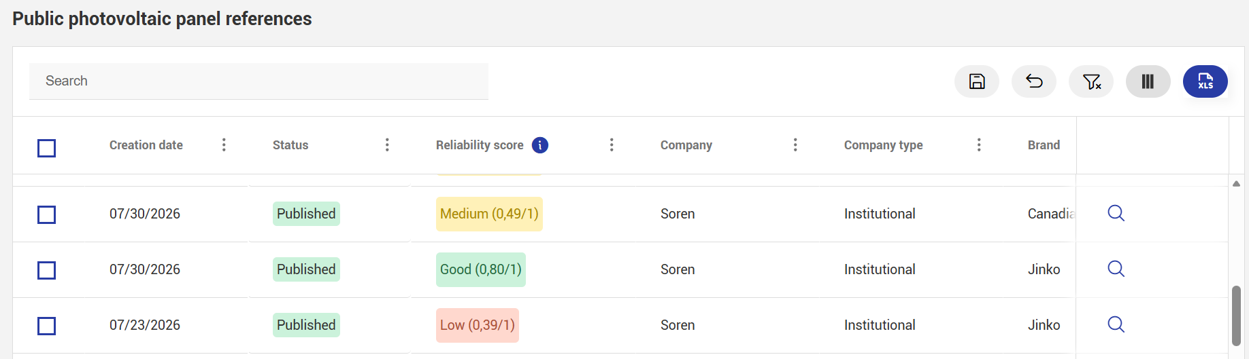
What's new
What is changing:
a redesigned simulator with direct display of eco-modulation eligibility
access to a public reference library (including a reliability index to measure the quality of the entered data)
For a more comprehensive and seamless experience

Slide 6
What is Ecodesign.solar?
Ecodesign.solar enables you to:
centralise the technical characteristics of panel references
automatically calculate several environmental indicators
identify design improvement opportunities
assess eligibility against eco-modulation criteria
submit and track attestation requests
view published panel references and environmental results
A single platform to support the eco-design of photovoltaic panels.

Slide 7
Who is the platform for?
Manufacturers, distributors and producers placing products on the market
create and manage their panel references
view environmental indicators
submit attestation requests
Engineering consultancies, installers and operators
assess a panel reference
view its characteristics and environmental results
Independent certification bodies
receive and review attestation requests
examine the submitted data and supporting documents
All types of visitors without an account
view a library of published references
use the simulator without an account
Features tailored to the different stakeholders in the photovoltaic sector.

Slide 8
The user journey
Create or select a panel
Enter its characteristics
Run the simulation
Analyse the environmental indicators
Test improvement options
Submit an attestation request
Track its review
Retrieve the compliance attestation
From the technical model to the attested result.
Entering Reference
Simulator
Attestation Request

Slide 9
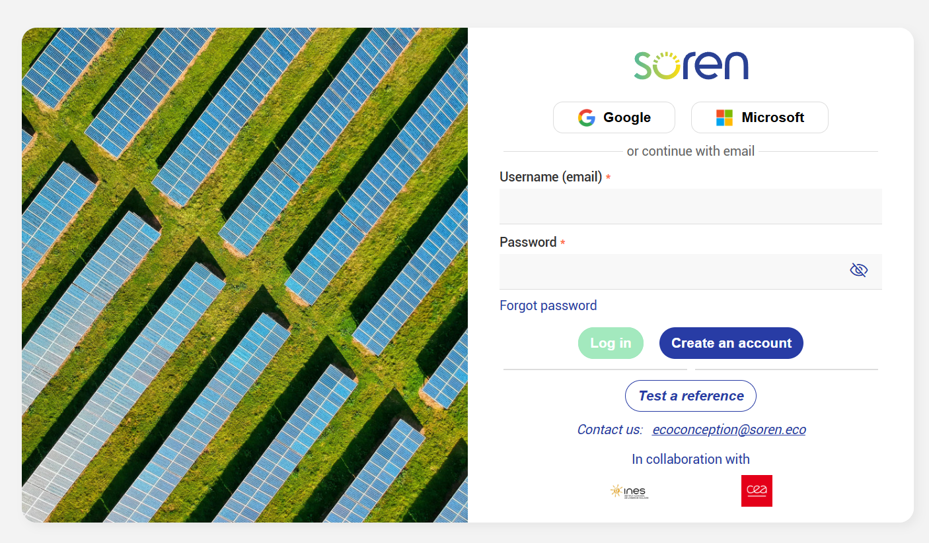
1 single platform2 access options depending on your needs
Login/account creation required for users wishing to run eco-design simulations and submit eco-modulation attestation requests
https://app.ecodesign.solar
A direct link, with no login required, to test a panel model
#SORENEWABLE

Slide 10
1. I am a user without an account and I want to check the compliance status of a known panel reference against the eco-modulation criteria
#SORENEWABLE

Slide 11
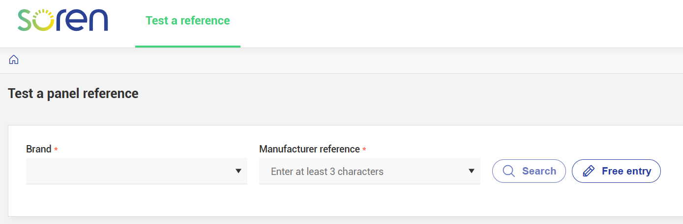
Test a model without logging in
Brand
→ All existing brands are already listed; simply select the one you want
Module model
→ It is essential to enter the module reference shown on the manufacturer’s datasheet
#SORENEWABLE

Slide 12
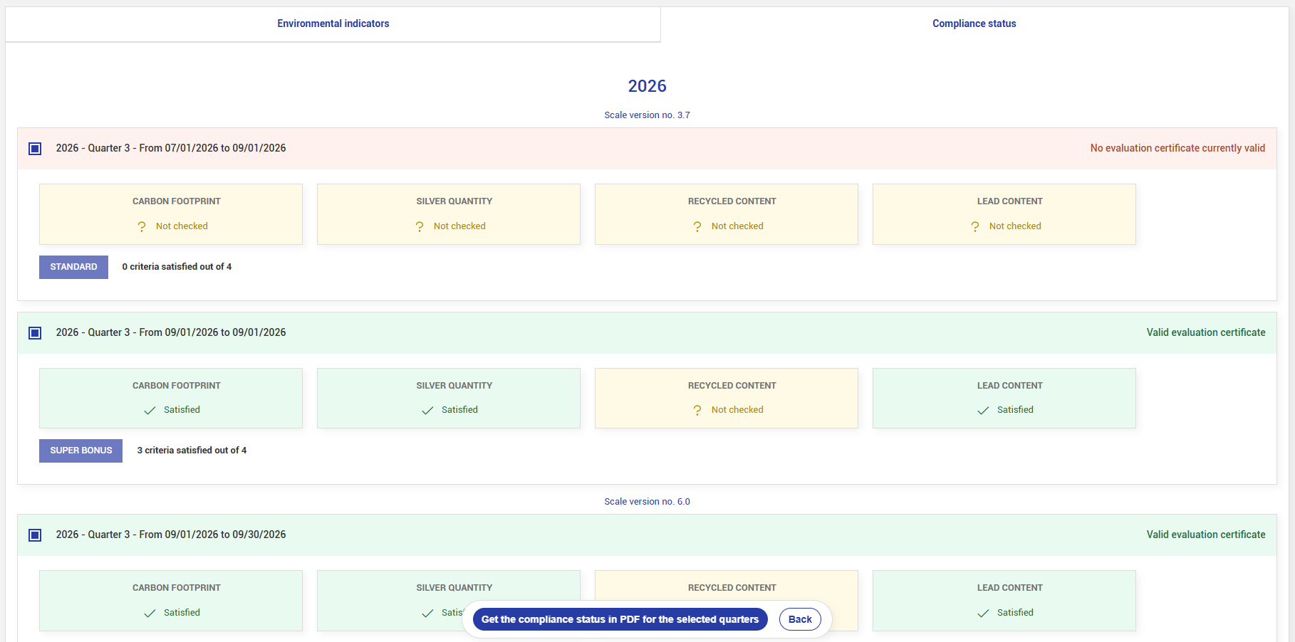
You can view the panel’s compliance over the selected period, with details for each criterion.

Slide 13
2. I am a logged-in user (with an account) and I want to know the environmental impact of a known panel reference
#SORENEWABLE

Slide 14
Steps to follow
Log in or create a user account
Create a panel reference
Make this panel private or public
Analyse the environmental results
(Start an attestation request)
#SORENEWABLE

Slide 15
1. Creating a user account
#SORENEWABLE

Slide 16
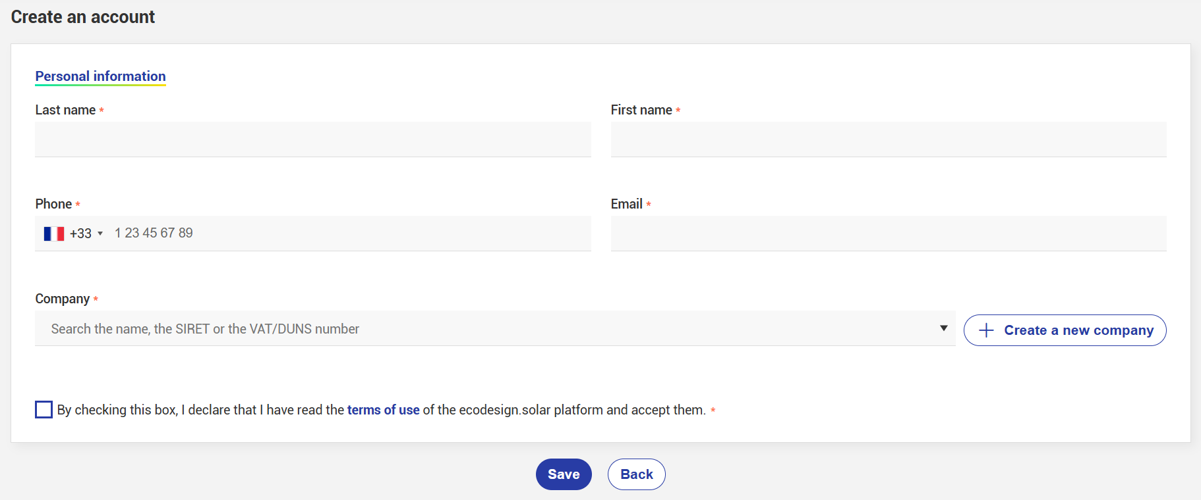
1. Creating a user account
Once the form has been submitted, you will receive a confirmation email enabling you to continue your registration (remember to check your spam folder).
The confirmation email contains a link to activate your user account. This link will take you to the password creation screen.
#SORENEWABLE

Slide 17
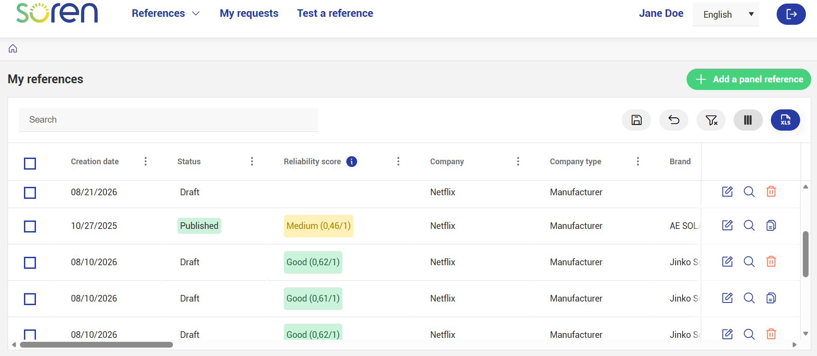
2. Create a panel model
You are taken to the My references menu, where you can create a model by clicking
“+ Add a panel reference”.
#SORENEWABLE

Slide 18
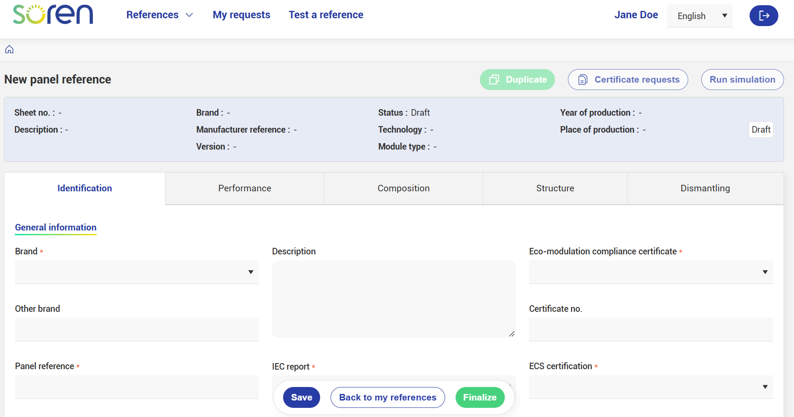
2. Create a panel model
Once you have completed the form, click Finalize. The reference will be set to Private status. Then run the simulation to obtain the results.
You will then access the creation form, where you must enter all required values.
If you miss a field, it will be highlighted in red.
You can also save the form with Draft status by clicking Save.
#SORENEWABLE

Slide 19
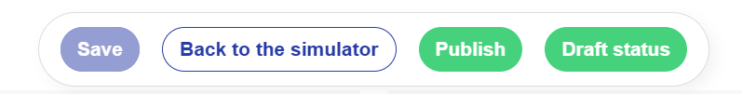
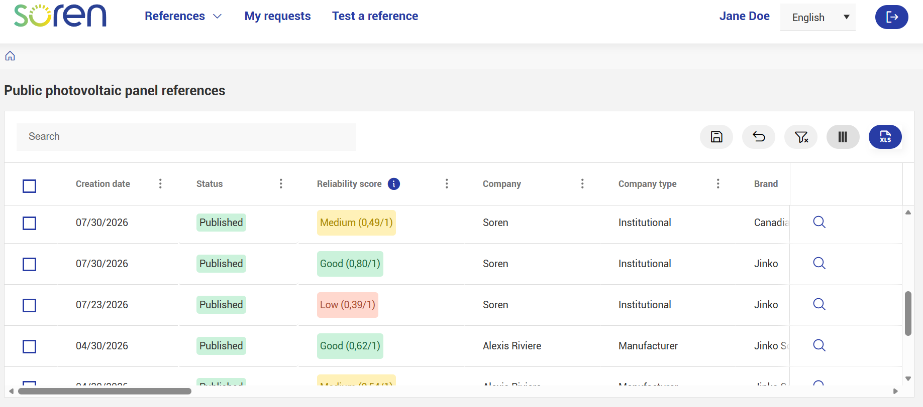
3. Make this model public
You can also change your reference to Public status.
This allows all logged-in users to view the environmental results of public references for comparison and improvement purposes.
In the Public models menu, only the simulation results can be viewed.
The input data remain confidential.
Please note: the Reliability Index assesses the robustness of the simulation results.
#SORENEWABLE

Slide 20
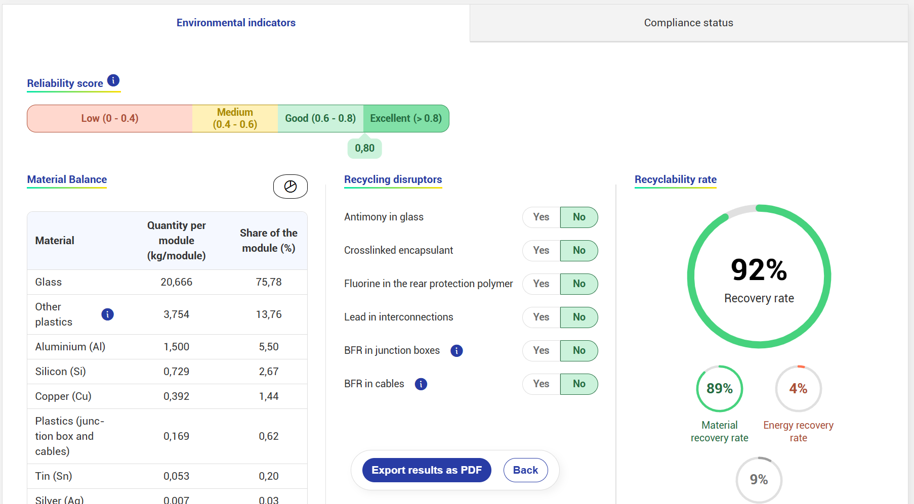
3. Analyse the environmental results
Understanding the results
You will find the environmental indicator results and the compliance status of your model against the eco-modulation criteria.
You can export these results in PDF format.
A guide explaining the results is available at https://assistance.soren.eco
#SORENEWABLE

Slide 21
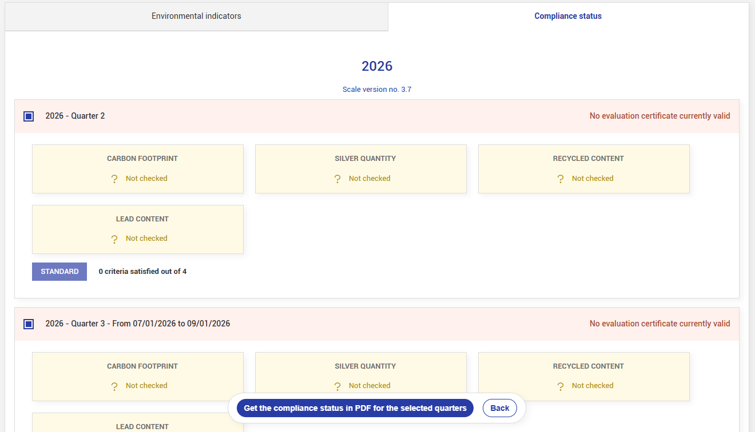
3. Analyse the environmental results
You will find the environmental indicator results and the compliance status of your model against the eco-modulation criteria.
You can export the compliance status in PDF format.
#SORENEWABLE

Slide 22
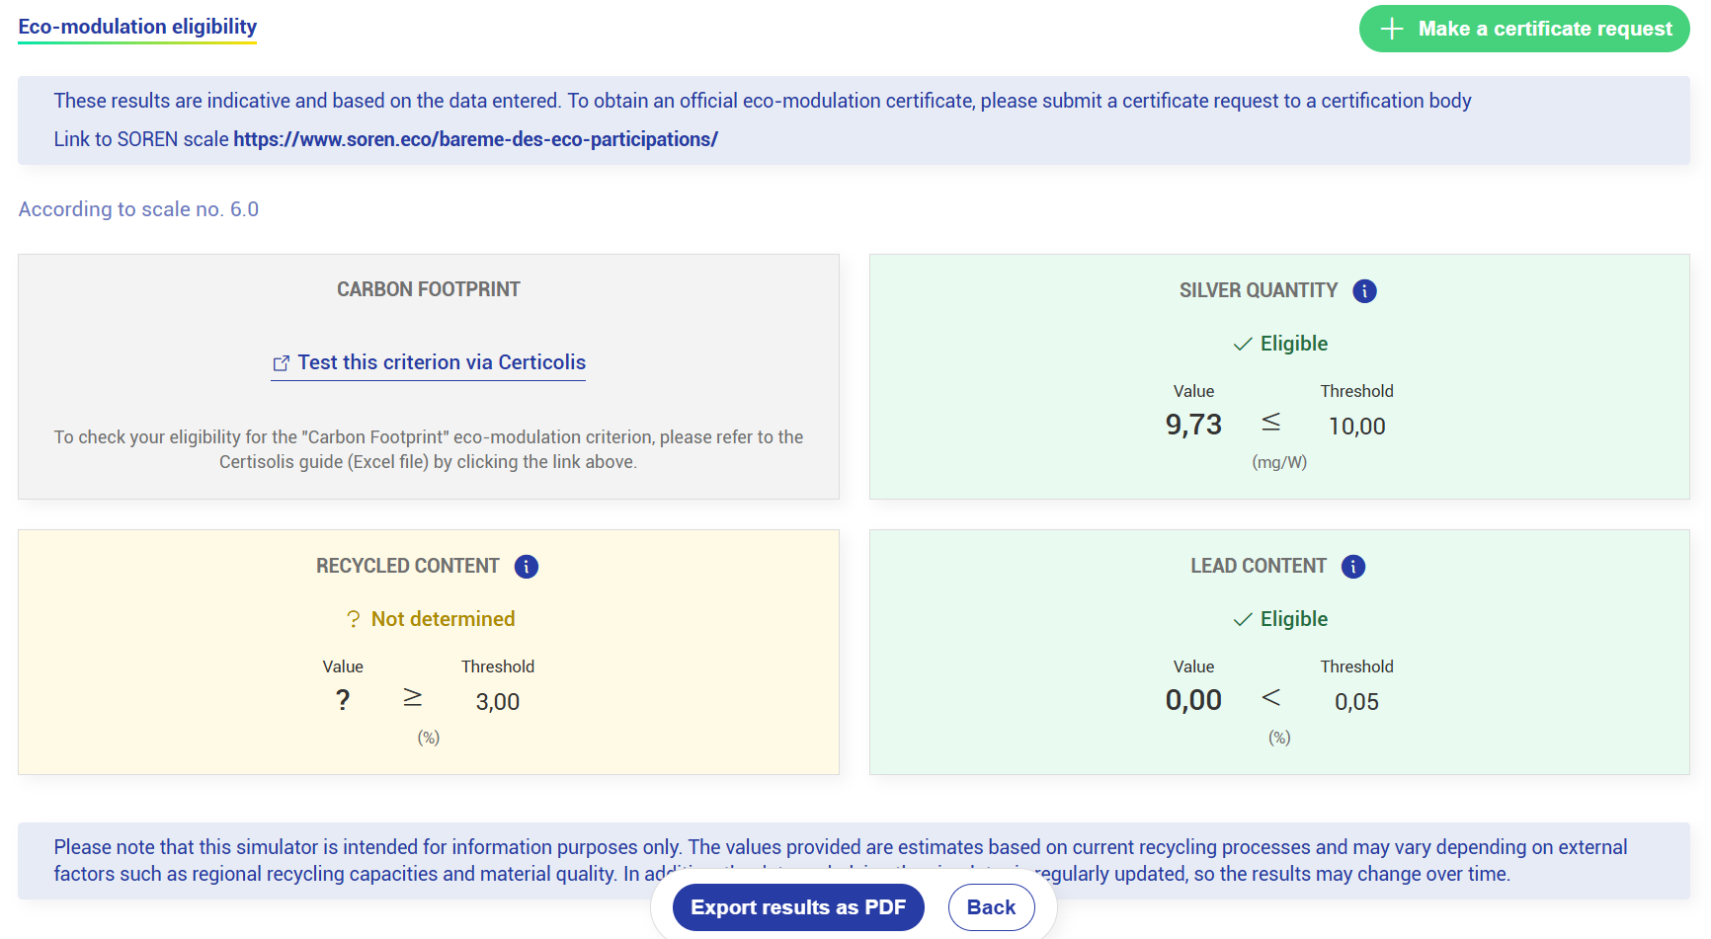
4. Start an attestation request
Based on the eco-modulation eligibility results.
Please note: these results depend on the quality of the data you enter.
To check eligibility for the Carbon Footprint criterion, please visit the Certisolis website directly
(https://www.certisolis.com/guide-critères-soren/)
#SORENEWABLE

Slide 23
3. I am a Soren member or an engineering consultancy and I want to submit a request for an attestation of compliance with the eco-modulation criteria

Slide 24
Steps to follow
Log in or create a user account
Submit an attestation request
  Select or create a panel reference
  Select an eco-modulation scale version
  Select the criteria to be assessed
  Upload the required supporting evidence
  Submit the request
#SORENEWABLE

Slide 25
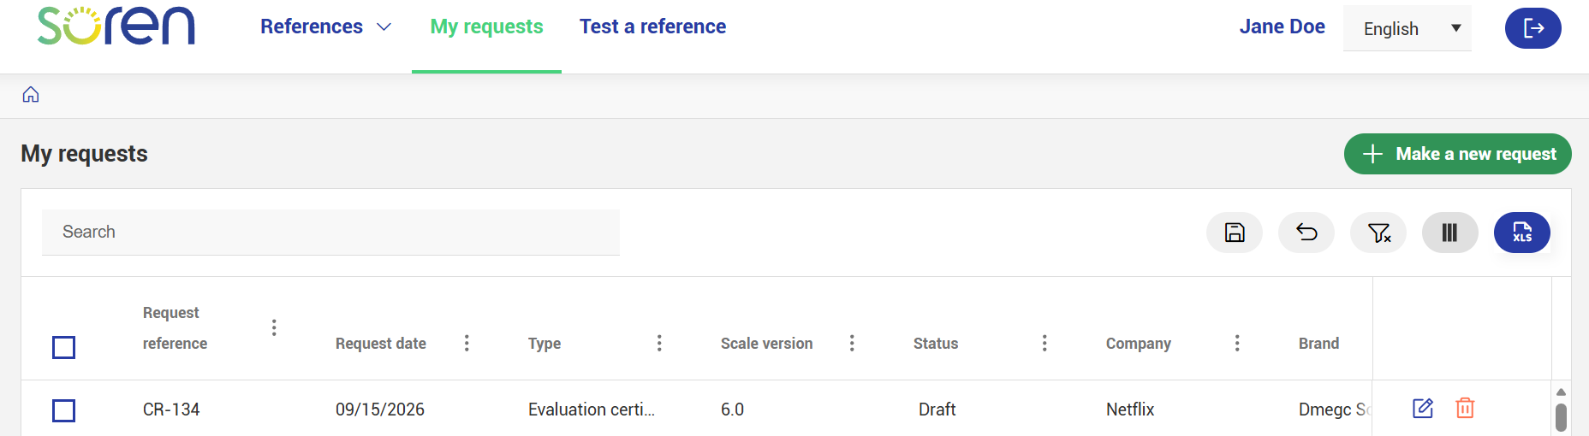
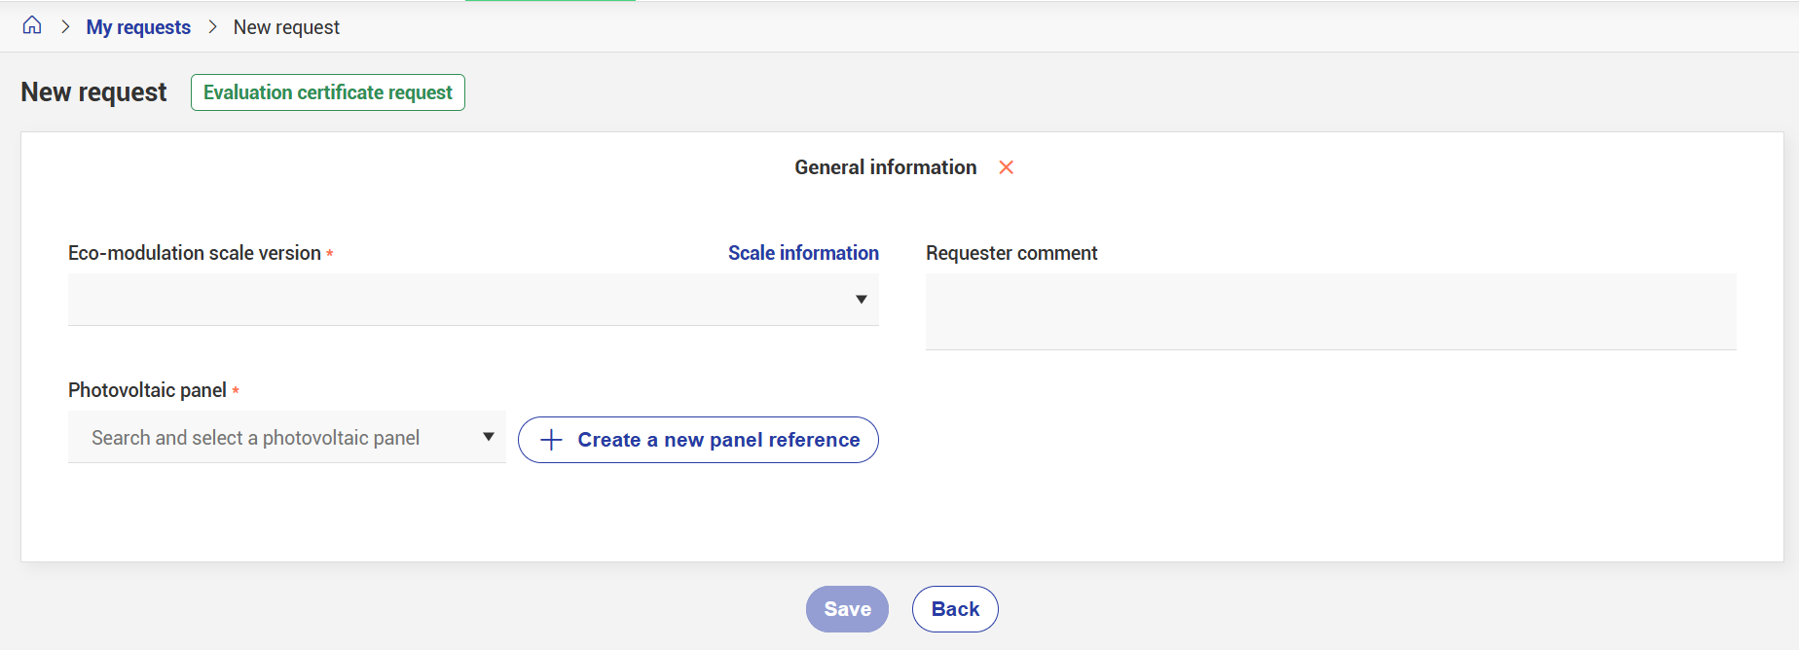
Submit an attestation request
Log in to your user account
From the My requests menu, click “+ Make a new request” to start the process
Select the current scale version
Search for your panel reference
To submit an attestation request for a photovoltaic panel reference, you must have a user account and have created a company.
#SORENEWABLE

Slide 26
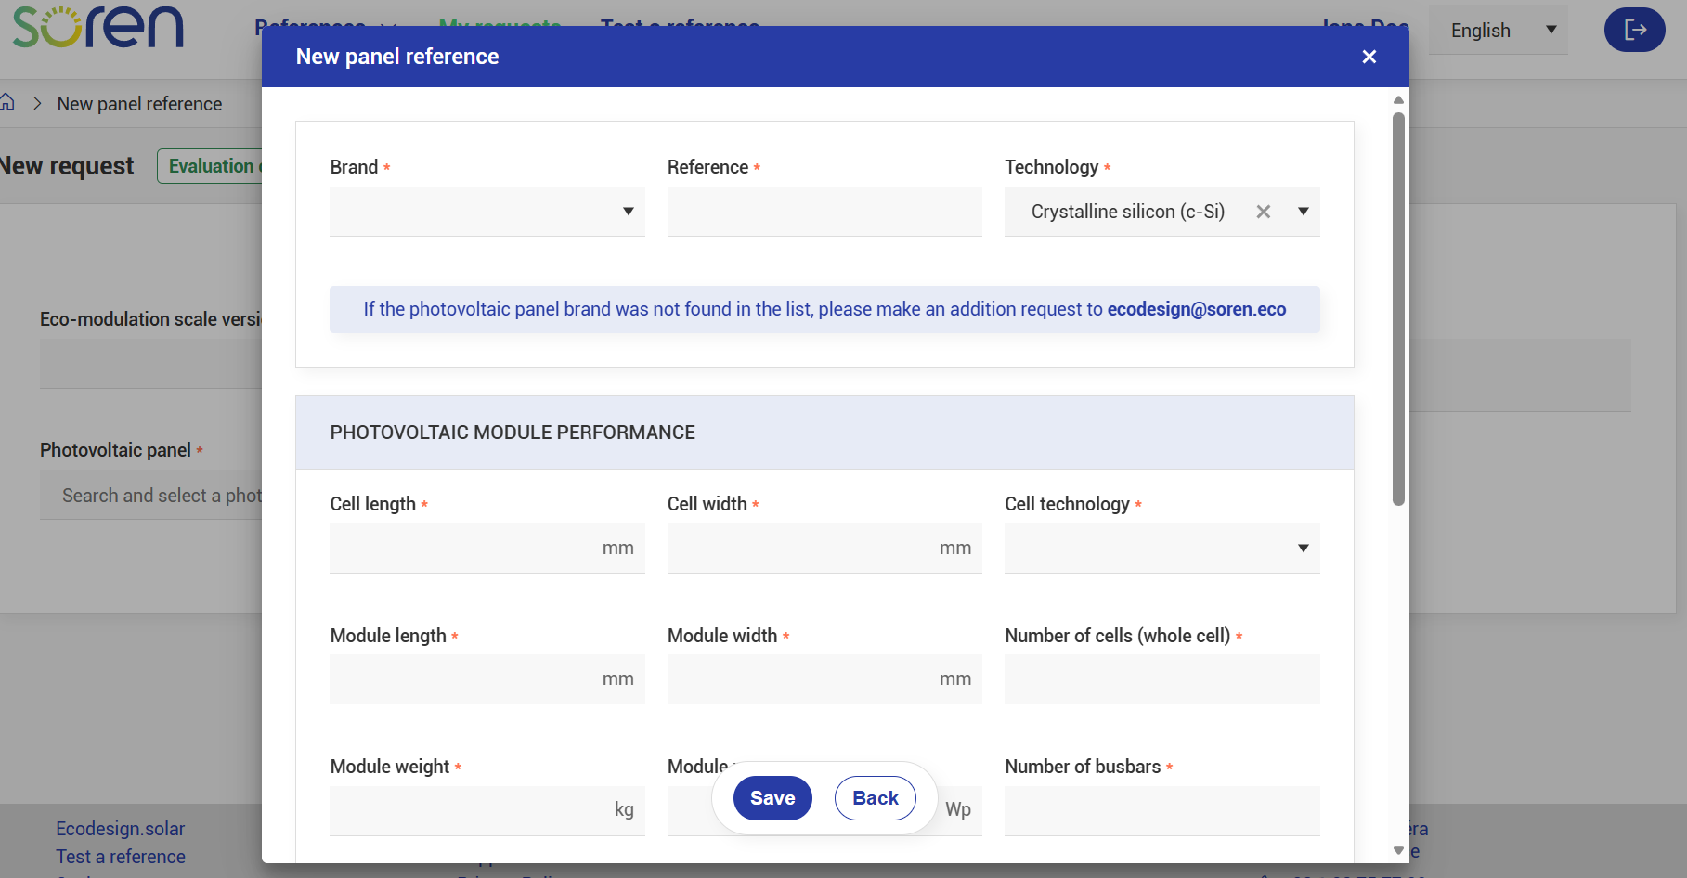
Submit an attestation request
5. Create the panel model by completing this simplified form
If the reference does not yet exist in the portal, you will need to create it before continuing.
If you cannot find your panel brand, contact us at ecodesign@soren.eco
#SORENEWABLE

Slide 27
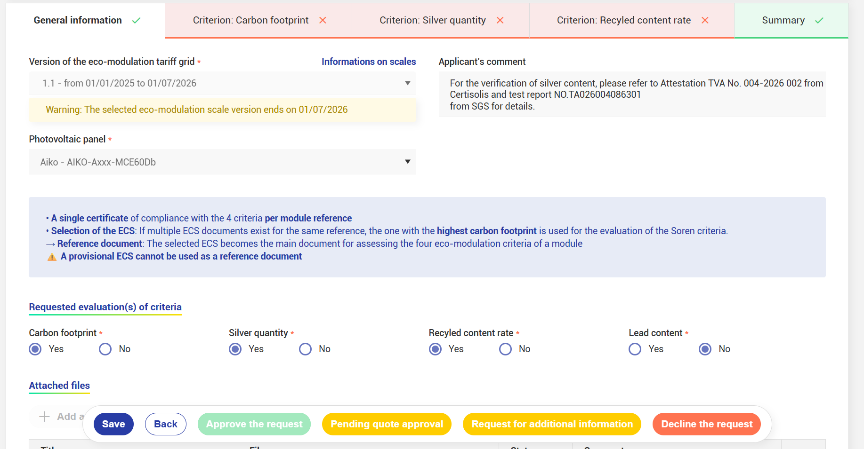
6. Select the eco-modulation criteria to be assessed
#SORENEWABLE

Slide 28
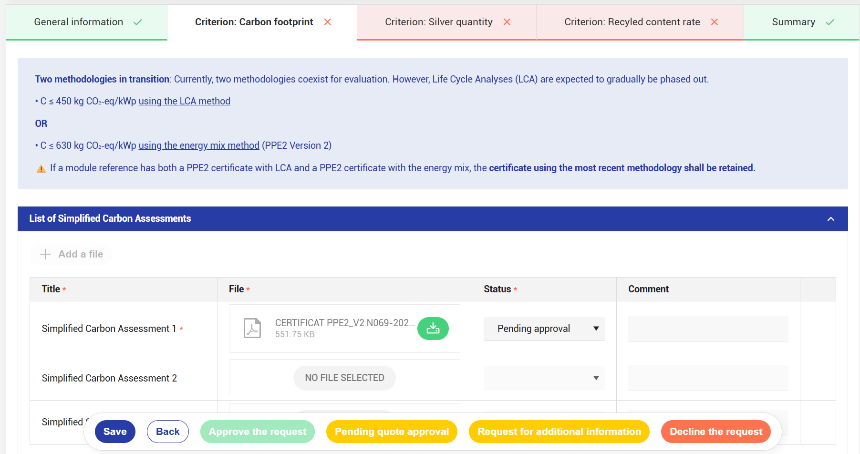
7. Upload all the required supporting evidence
#SORENEWABLE

Slide 29
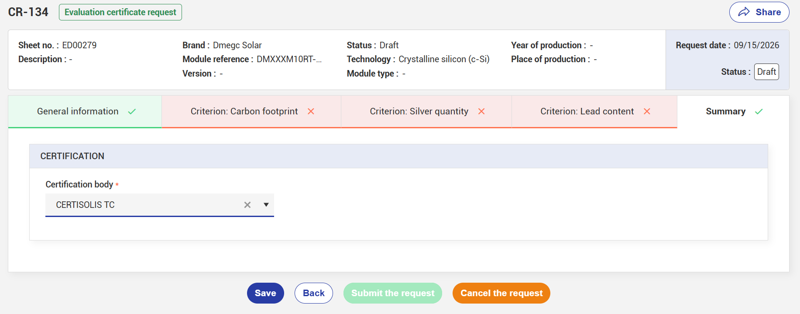
Submit an attestation request
To submit your attestation request:
Select your certification body in the “Summary” tab
Click “Submit request”
You’re almost there…
If required information is missing, the button will remain greyed out. In this case, check the form again.
#SORENEWABLE

Slide 30
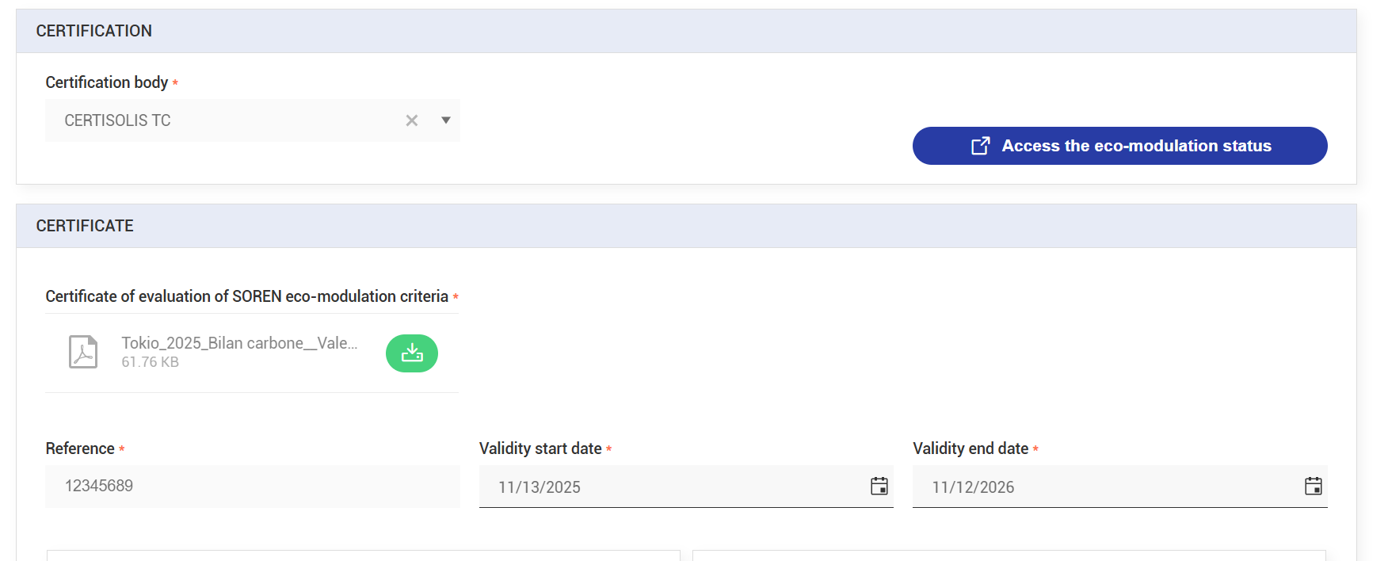
Next steps
Agreement between the parties (outside the platform)
Request completeness check
Assessment by the certification body
Upload of the attestation to the applicant’s account
#SORENEWABLE

Slide 31
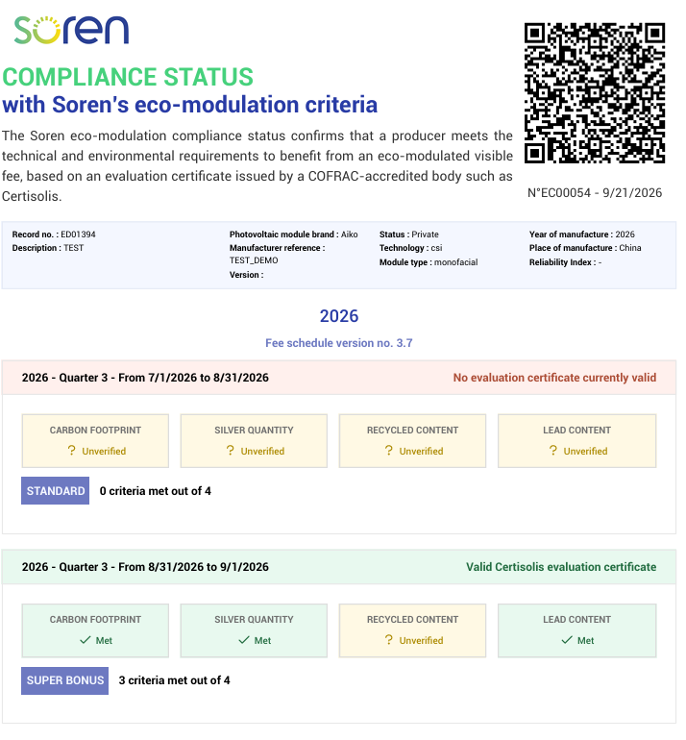
Soren compliance status
Once the attestation has been uploaded, it is not disclosed, as it remains the applicant’s property. However, the compliance status of the relevant model will indicate the corresponding bonus level.
#SORENEWABLE

Slide 32
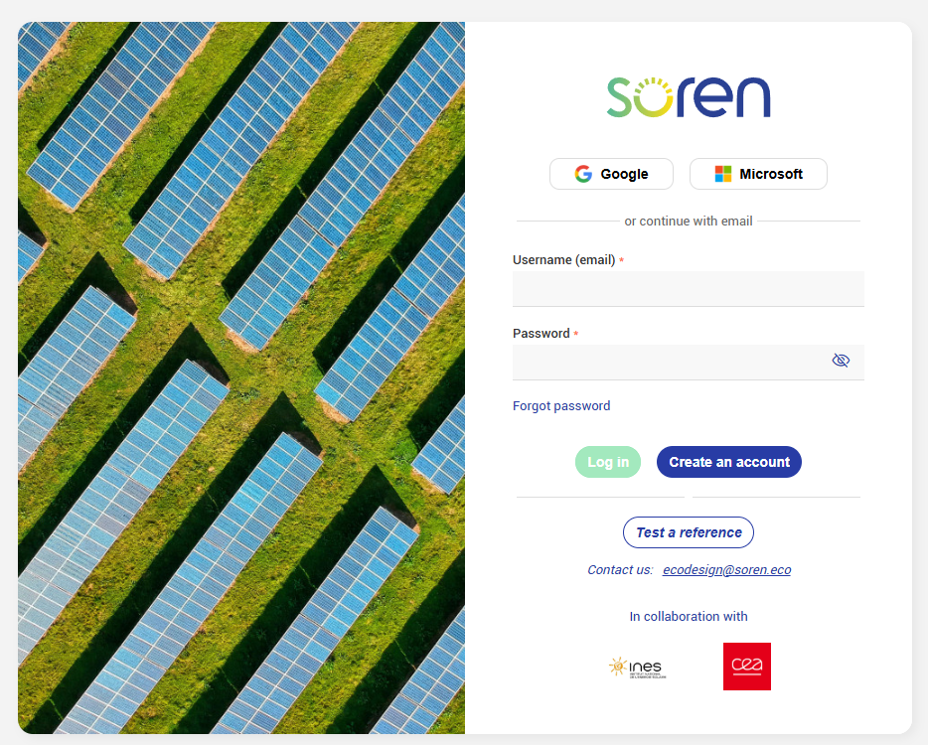
Let's go to Ecodesign.solar platform
Demonstration
https://app.ecodesign.solar
#SORENEWABLE

Slide 33
Thank you for your attention!
Any questions?
ecodesign@soren.eco

Slide 34






@soren_eco
#SORENEWABLE

